Slide 1

Working with the Division of Purchases (“Purchases”): The Benefits of Agency Partnerships: Purchases 101
Nancy McIntyre, Purchasing Agent
Michael Mitchell, Esq., Deputy Purchasing Agent
October 2017

Slide 2
Working with the Division of Purchases
Mission and Functions | Purchases is the centralized procurement authority for the State of Rhode Island. Our goal is to obtain the best value for the taxpayer. This can be accomplished by providing an "equal playing field" for all potential vendors, enhancing opportunities for small businesses, minority/women owned businesses, and disability business enterprises, and by leveraging State purchasing power on all procurements.
Staff Structure and Workload | 29 staff including 12 buyers Annually solicit over 1,000 bids which includes Request for Proposal (RFP), Request for Quote (RFQ) and Request For Information (RFI). This is non-inclusive of sole/single source requests, emergency procurements, mini-bids, grants and delegated authority procurements. Management of the life cycle of the contracts issued, e.g. change order process. Consultative services to agencies and vendors and MPA contract management.

Slide 3
Purchases Overview
R.I. Gen. Laws §37-2-1, et. seq. “State Purchases Act”
Working with the Division of Purchases
Procurement Regulations and General Conditions of Purchase
Public procurement concepts
Determining the procurement method

Slide 4
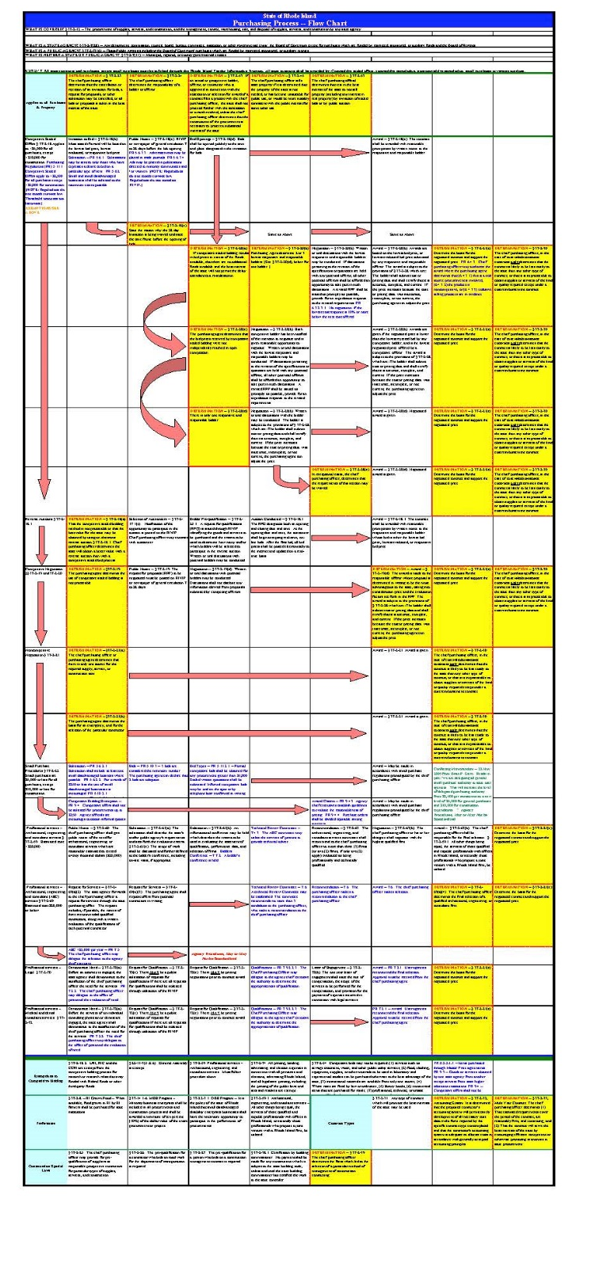
State Purchases Act Flow Chart

Slide 5
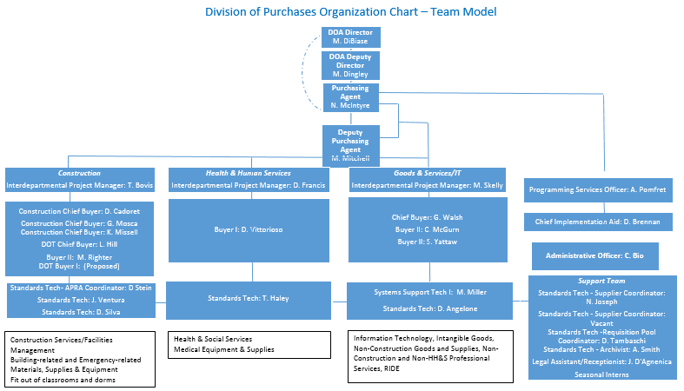
Division of Purchases Organization Chart- Team Model

Slide 6
Working with the Division of Purchases:
Benefits of Agency Partnerships
An upfront investment in Strategy and Needs Assessment, and Purchases partnership, can lead to a more effective and timely procurement process.
For best outcomes:
Upfront needs assessment
Open dialogue with stakeholders
Cooperative procurement planning reduces delays caused by:
Bid protests/legal challenges
Unclear agency objectives and strategy
Poor or overly ambitious timeline management at agency level
Insufficient funding

Slide 7
Working with the Division of Purchases:
When and How to Partner on an RFP Project
RFP services should be rebid 12 months prior to contract expiration
Review and update scope of work/specifications
Review and update evaluation criteria
Consider an RFI for thorough market research
Consult with Purchases upon approved scope of services at agency
Prior to submission of a requisition for solicitation posting, discuss with Purchases the associated scheduling and buyer availability

Slide 8










Some Procurement Perspective…

Slide 9

Public Procurement Concepts
Full & open competition
Transparency
Established procedures
Support of socioeconomic goals

Slide 10
Working with the Division of Purchases: Procurement Methods
Option | Description | Application | Timing
Master Price Agreement (MPA) Multiple award | Solicited as RFP or RFQ Universal need for goods or services Provides agency access to qualified vendors Caps for pricing Caps for project cost | Agency expedited process May provide agency opportunity for mini-bid 3 quotes | Similar to an RFP/RFQ Award may be issued for multiple years with renewal options
Continuous Recruitment (CR) Multiple award | Prequalified vendor list Vendor proposal submission is ongoing | May also be an MPA | Ongoing solicitation that allows vendor entry to the qualified list over a greater length of time (exceeds the RFP/RFQ 28-day timeline)

Slide 11
DOA / Purchases Shortcuts: Master Price Agreements “MPA”
Universal need for goods / services
Create your own release / direct purchase order - Read MPA user guide specific to the MPA - $0 (zero dollar) purchase agreement requisition often required
Multi-state cooperative agreements (NASPO, NJPA, US Communities)
MPAs listed on www.purchasing.ri.gov

Slide 12
Small Purchase Delegated Authority and Delegated Authority Explained
Small Purchase Delegated Authority
Amounts between $500 and $5000 for goods & services
Amounts between$500 and $10,000 for construction services
Use of MPA, MBE/WBE and local vendor when possible
Delegated Purchase Authority For Agencies
Request for limited delegated authority to DOA Director as Chief Purchasing Officer
Authorization letter from DOA Director/Chief Purchasing Officer
Program/Agency specific

Slide 13
Architectural, Engineering, or Consultant Services Under $20,000 (R.I. Gen. Laws §37-2-69)
Agency obtains 3 written quotes
Agency recommends award to lowest responsive, responsible bidder
Every effort should be made to contact Rhode Island vendors and at least one Minority Business Enterprise (“MBE”) vendor
Agency sends requisition, quotes, and recommendation to DOA / Purchases
DOA Director has final approval

Slide 14

Small Purchases: Delegated Authority
DO NOT Artificially Divide Procurement

Slide 15
If there is no MPA/CR and need does not fall within Small Purchases Delegated Authority, Interface with DOA / Purchases
The Purchase Requisition:
Statement of Need (Tell us what you want.)
Created on-line in RIFANS
Provides a funding source
Provides a description of goods/services
Authorizes the Purchasing Agent to act on behalf of the agency

Slide 16
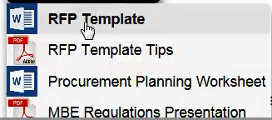
Methods of Public Solicitation
Request for Proposals: RFP
Request for Quotations: RFQ
Request for Information: RFI – No Award
Get templates and check list
at the ARC

Slide 17
Working with the Division of Purchases: Procurement Methods
Option | Description | Application | Timing
RFP: Awarded on best value | Incorporates a defined scope of work Technical and cost component Technical review team scores proposals based on expertise | Typically services based When technical expertise is critical to the project | 28 days posting 1 – 2 months technical review 21 days for tentative award 7 days purchase order issued. Important: No work to commence without a purchase order

Slide 18
Working with the Division of Purchases: More Info and Next Steps
Roll out of new Agency RFP Planning Tool. Get it online at the “ARC”
Purchases and several agencies
Recently participated in a “Results-Driven Contracting Strategies” Workshop with the Harvard Kennedy School.

Slide 19
Request For Proposals “RFP”
Did you know?
Purchases created a check list to guide you through the RFP Process. The “ARC” should be accessed each time you draft an RFP to ensure the most current version of the RFP Template and RFP Checklist are used.
Click here to visit the ARC.
Government knows end result. Solicitation to determine best approach to resolution
Evaluation Criteria: Experience, approach, methodology, work plan & cost; subjective - sliding scale
Cost or budget justification
Specifications – end results oriented by statement of work
Bid Opening – offers are acknowledged; no details discussed
Evaluation – weighted values on multiple criteria (usually technical 70%, Cost 30%)
Discussion – among review team and offeror
Changes – offeror’s ideas may be used in best and final round
Award – best value, maybe not lowest price

Slide 20
Methods of Public Solicitation Ctd.
Request for Quotation “RFQ”
Specifications – failure to adhere to all specifications means bid is rejected.
Award to lowest responsive / responsible bidder
Example: motor vehicle procurement

Slide 21
Working with the Division of Purchases: Procurement Methods
Option | Description | Application | Timing
RFQ: Awarded to lowest responsive responsible bidder | Fixed, limited scope of work | Goods, construction | 28 days posting 1 – 2 week for review 7 days purchase order issued. Important: No work to commence without a purchase order

Slide 22
RFQ
Specifications – specific as to performance / design. Failure to adhere to all specifications results in bid being rejected.
Bid Opening – public, all data available to other bidders
Evaluation – based exclusively on technical specifications
Discussion – yes or no on meeting specification
Changes – none; no discussions
Award – lowest responsive & responsible offer

Slide 23
Public Procurement Concepts: Responsive
A proposal (bid) which conforms in all material respects to the solicitation.
Determination takes place at the time of offer evaluation.

Slide 24
Public Procurement Concepts: Responsibility
Offeror has the capability, in all material respects, to perform the contract.
Capability includes:
Experience
Integrity
Reliability
Capacity
Facilities
Equipment
Financial resources & management capability

Slide 25
Working with the Division of Purchases: Market Research Options
The RFI is used to gain expertise from industry leaders:
Option | Description | Application | Timing
RFI: No award | Collects written information about the capabilities of the market Interview/demo is an additional option available Information used to develop robust, on-target RFP scope of work | When agency wants additional information on available services and providers before designing RFP Way to signal vendor interest in service area | Posted for 28 days 1-2 month review Allow adequate time to develop RFP that incorporates discoveries from RFI

Slide 26

http://www.purchasing.ri.gov/bidding/BidDocuments.aspx?BidNumber=7549521&Isridot=False&Status=Canceled
Start of Open Enrollment
11-1-15
Transition to AHS
4-1-16

Slide 27
Sole Source Awards 37-2-21(a)
What is a Sole Source?
A sole source procurement is a procurement where only one source is practicably available for the goods or services required.
What is a Single Source?
A single source procurement is one in which two or more vendors can supply the commodity, technology and/or perform the services required by an agency, but the State agency selects one vendor over the others for reasons such as expertise, availability, critical need or previous experience with similar contracts.
What do I need to submit with a Sole Source or a Single Source?
Submit justification form with requisition
Get it online at the “ARC”
Detailed response for every justification question required

Slide 28
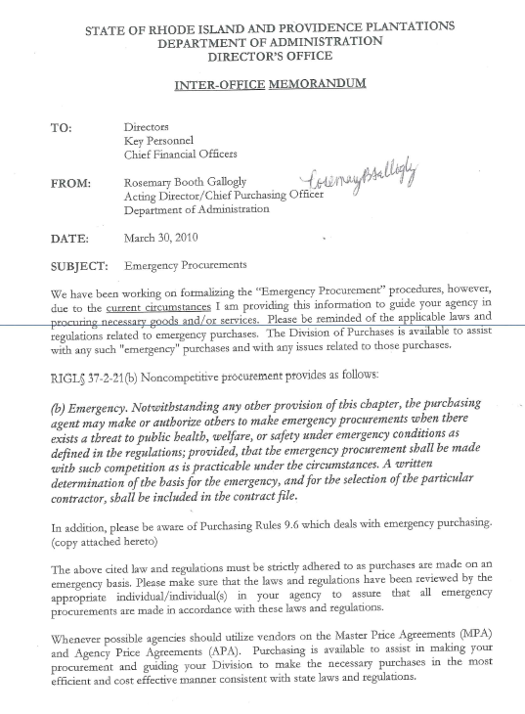
Emergency Procurements 37-2-21 (b)
Exists a threat to public health, welfare or safety
Written detailed description of the basis for the emergency required
Inadequate anticipation of need shall not be considered justification for “emergency” purchases
Repairs are limited to only those necessary to address the emergency situation.
Submit all vendor invoices and requisitions ASAP
Emergency Procurements

Slide 29
Delegated Purchase Authority for Agencies
2.2.3.1 - Delegated purchase authority shall mean the transfer of purchasing authority from the Chief Purchasing Officer to another state official
2.2.3.1.4.1 - Names and titles of individuals authorized by an agency director to commit funds on behalf of an agency
Delegated purchase authority may be revoked if at any time a user agency is deemed to be in violation of purchasing rules and regulations, policies and procedures
Purchase order, batch payment, - must be outlined in the request for delegated purchase authority
Subject to review by Bureau of Audits

Slide 30
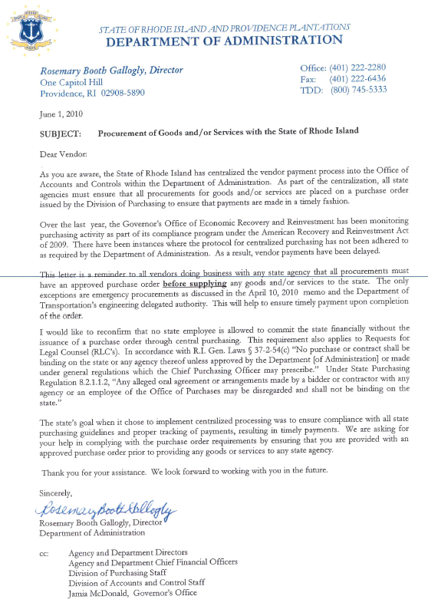
Purchase Order / Contract Award
Standard Purchase Order:
Total award $ specified
Funds encumbered
Blanket Purchase Agreement:
- Capped
- Term stated
- Lines established with unit price and unit of measure
- Funds encumbered at release “Blanket Release”
Contract Purchase Agreement:
- $ capped
- Term stated
- No lines in RIFANS on a contract purchase agreement
- Funds encumbered at release (contract release identified as Standard Purchase Order in RIFANS with supplier site of “99”)
Goods/Services Memo

Slide 31
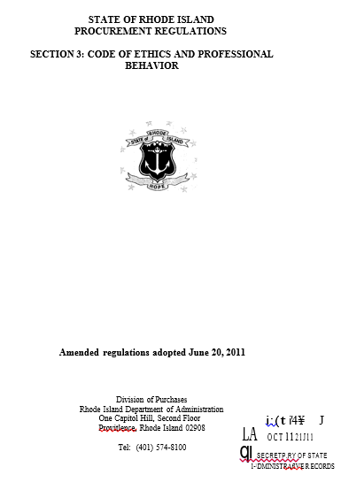
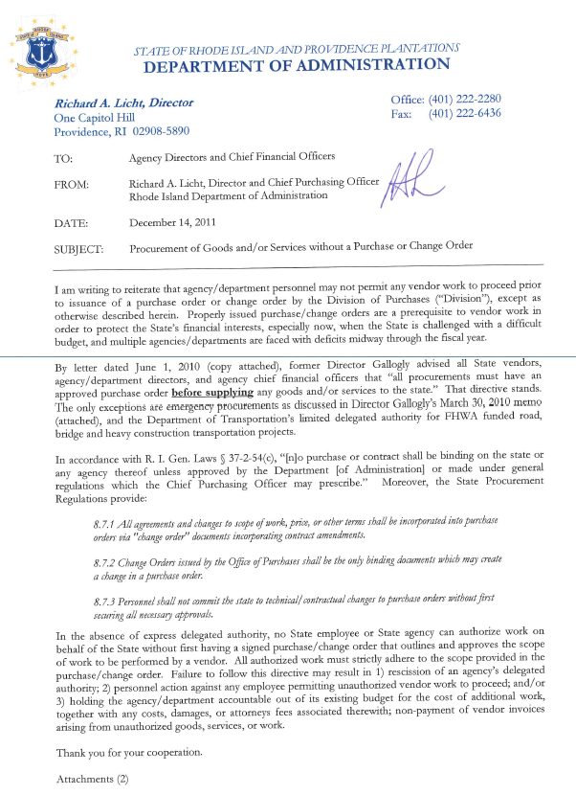
Change Orders Issued by DOA/ Purchases
Procurement Regulations
Procurement Regulation 8.7-Changes to Purchase Orders
8.7.1 All agreements and changes to scope of work, price, or other terms shall be incorporated into purchase orders via "change order" documents incorporating contract amendments.
8.7.2 Change Orders issued by the Office of Purchases shall be the only binding documents which may create a change in a purchase order.
8.7.3 Personnel shall not commit the state to technical/contractual changes to purchase orders without first securing all necessary approvals.
8.7.4 All discussions of potential changes (oral or written) may be disclaimed as not being binding on the supplier or the State until formally incorporated into the purchase order.
8.7.5 In general, change orders shall be issued by the Office of Purchases following receipt of quotations and discussions of price and delivery with the supplier. If circumstances preclude immediate issuance of a formal change order, interim direction to the supplier may be made via a letter of authorization signed by the Purchasing Agent.
Director’s Procurement Memo Re: Change Orders

Slide 32
GRANTS
10.1.3 “Grants” shall mean monies provided by the state to or on behalf of individuals or entities to underwrite specific costs of services or programs. Although grants may be distributed for specific purposes, payment is not based upon supply of specific units of service or products.
5.3.3.1.3 “Grants” in the form of general subsidies or assistance shall be administered by state agencies in accordance with legal mandates restricting or defining the use of such funds.
$ distributed specified in grant
$ distributed by formula
$ distributed by competition
Requisition to DOA/Purchases with supporting documentation
Delegated authority letter required in many cases

Slide 33

Agency Specific Delegated Authority
Requisition
Delegated authority letter
Vendor-agency agreement
Send to Director of Administration/Chief Purchasing Officer

Slide 34
Poor Vendor Performance The Deficiency / Complaint Process
Agency attempts to resolve first
Notify DOA / Purchases if unresolved
Complaint form available at the “ARC” Click here
Resolution: compromise, suspend, debar, legal action

Slide 35
Working with the Division of Purchases: More Info and Next Steps
What’s New?
Roll out of Purchases team concept in 2017
ARC – Agency Resource Center is online and is continually updated with business processes, training materials and templates
NEW TOOL Quick Start Guide to Procurement for Onboarding
1 Page Handout

Slide 36
Working with the Division of Purchases: More Info and Next Steps
The Purchases website is a valued resource for agencies to use in reviewing posted solicitations, MPA user guides, and general Purchases information, rules, regulations and legislation.
Always use the most recent version of templates, forms and tools.
Get them on the ARC
NEW TOOL Check list for RFP Process
7 Page Handout

Slide 37
MPA Search Tips
Handout provided featuring MPA Search Tips and MPA #494 User Guide

Slide 38
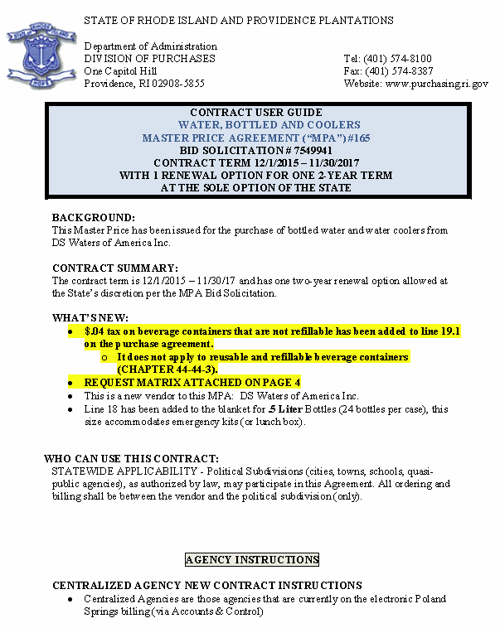
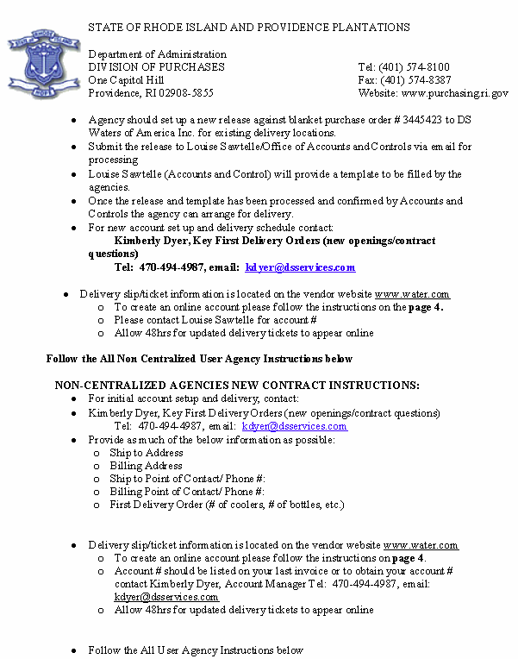
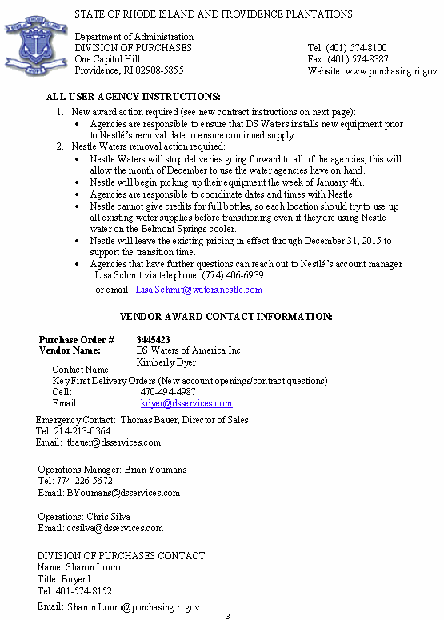
User Guides Are Available On the Purchases MPA Website
Note that User Guides are not accessible in RIFANS

Slide 39

Code of Ethics and Professional Behavior
Michael Mitchell, Esquire
Deputy Purchasing Agent

Slide 40
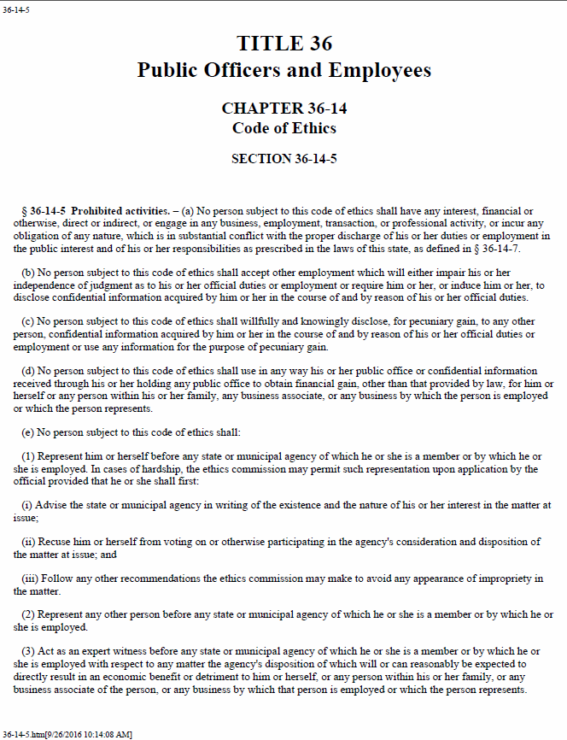
Code of Ethics and Professional Behavior
3.3 Prohibited activities under the Rhode Island conflict of interest statutes (R. I. Gen. Laws § 36-14-5):
3.3.5 No person subject to this code of ethics or spouse (if not estranged) or dependent child or business associate of such person or any business by which said person is employed or which such person represents, shall solicit or accept any gift, loan, political contribution, reward, or promise of future employment based on any understanding that the vote, official action or judgment of said person would be influenced thereby.
Code of Ethics & Professional Behavior

Slide 41
Code of Ethics and Professional Behavior
3.4.1 Universal Code of Ethics applicable to all state employees involved in the procurement process:
3.4.2.5 Under no circumstances may a vendor provide to a procurement official nor may a purchasing agent accept any goods or services, regardless of monetary value, for personal use for less than fair market value.
3.4.2.6 Personnel are prohibited from accepting gifts or gratuities in any form for themselves or their families …from contractors, subcontractors or suppliers…
3.4.2.6.1 Gifts or gratuities shall mean, but are not limited to money, merchandise, advertising media, gift certificates, trips (individually or in groups), cock-tail parties, dinners, evening entertainment, sporting events, etc., and any merchandise carrying a vendor’s name or logo

Slide 42
Code of Ethics and Professional Behavior
3.4.2.7 Social interaction between personnel involved in the procurement process and any present or prospective contractors, subcontractors or suppliers and their representatives creating the impression of favoritism shall be avoided.
However, this regulation does not prohibit social interactions between state employees and representatives of suppliers which are clearly of a personal nature, in which the parties involved would normally be expected to reciprocate, and in which no reimbursement from the state is sought by the employee. For example, the supplier’s representative may be an acquaintance, neighbor, relative or former state employee. The responsibility rests on the individual employee to regulate his/her own actions and to seek advice from Purchasing Management or the Ethics Commission if concerned about an apparent conflict of interest.

Slide 43
Code of Ethics and Professional Behavior
3.4.4.1 Resolution of conflict may include, but shall not be limited to, the following measures:
3.4.4.1.1 Reassignment of the procurement official or other state employee involved;
3.4.4.1.2 Termination of employment of the procurement official or other state employee involved; and
3.4.4.1.3 Debarment of any and all vendors who may be involved.
3.4.9 Purchasing personnel shall not make purchases for personal use in the name of the state or through the use of any state procurement forms.

Slide 44

Congratulations! You’ve completed Purchasing 101

